Slide 1
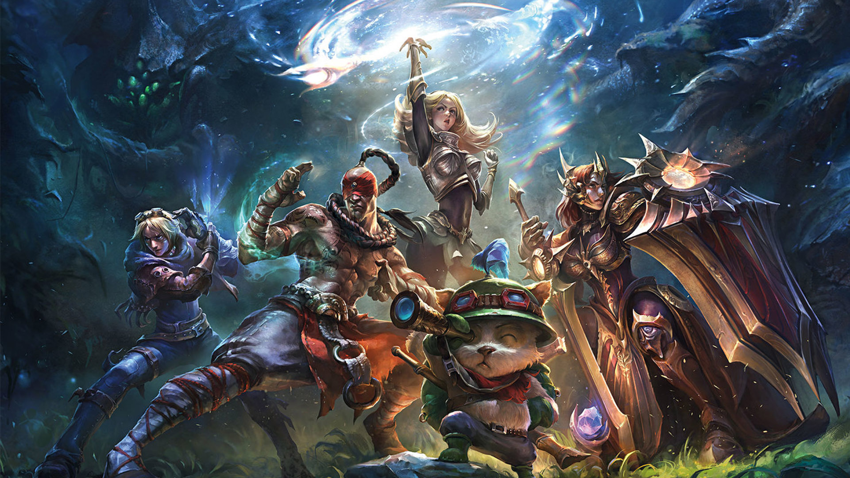



Predict the outcome of the ranked game in league of legends
Yunxuan Zeng
Data Science Initiative
Brown University
12/3/2020
https://github.com/YunxuanZeng/1030Project

Slide 2
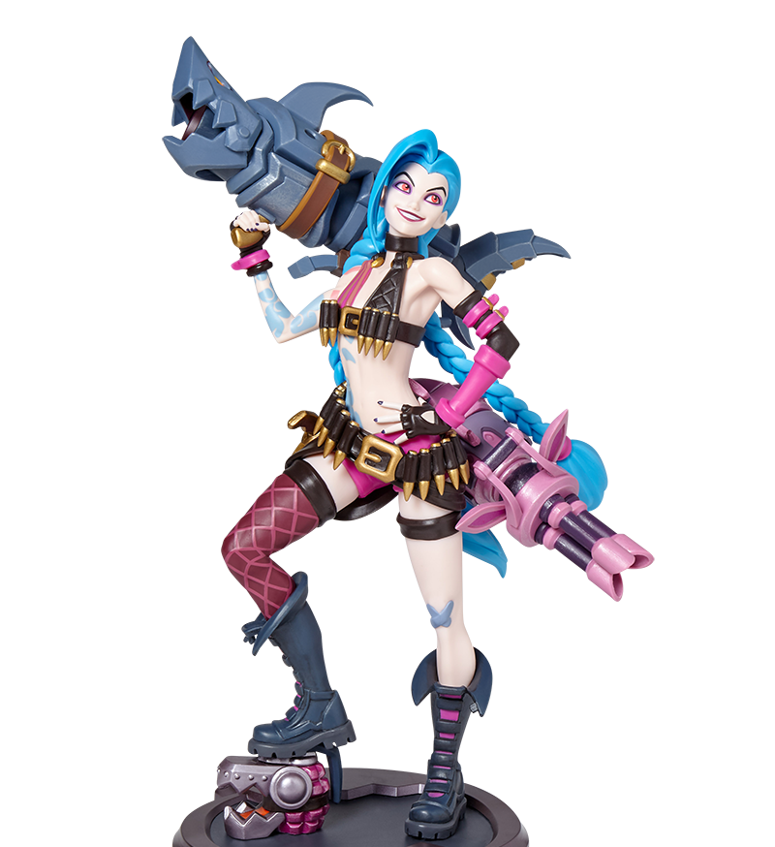

Outline
Introduction & EDA
Data Splitting
Cross Validation Pipeline
ML Algorithms
Results
Outlook

Slide 3

Introduction
Dataset: League of Legends Diamond Ranked Games (10 min)
9879 ranked games
19 features per team (38 in total)
Target variable: blueWins (0/1)
Link: https://www.kaggle.com/bobbyscience/league-of-legends-diamond-ranked-games-10-min
Classification Problem:
Predict the winner of a ranked game based on the statistics of two teams in the first 10 minutes
Significance:
Popularity
Diversity and Inclusion
Fairness

Slide 4
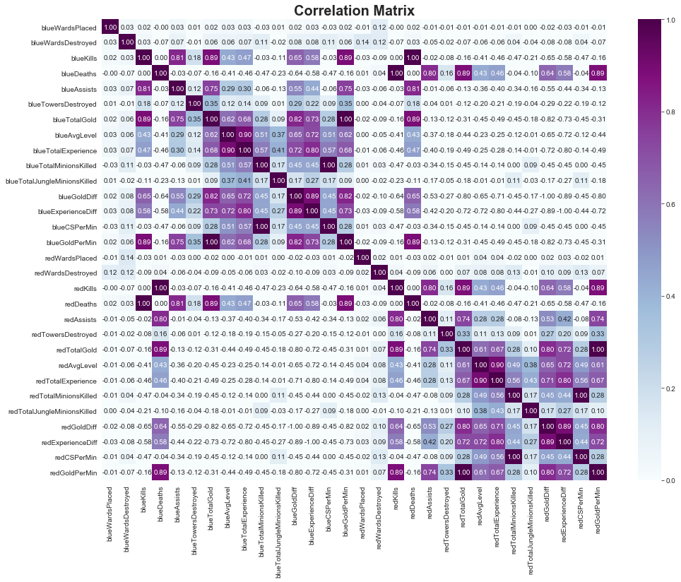
Exploratory Data Analysis
Positive Relation:
Blue total gold & blue kills/assists
Blue total gold & blue gold/experience diff
Blue Avg Level & blue total experience
Negative Relation:
Blue total gold & blue deaths
Blue Avg Level & blue deaths

Slide 5
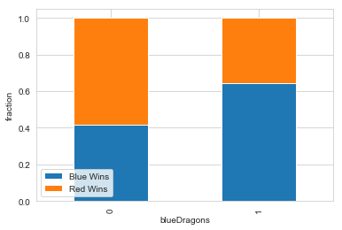
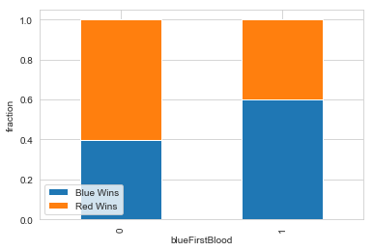
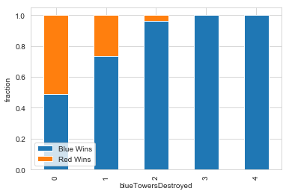
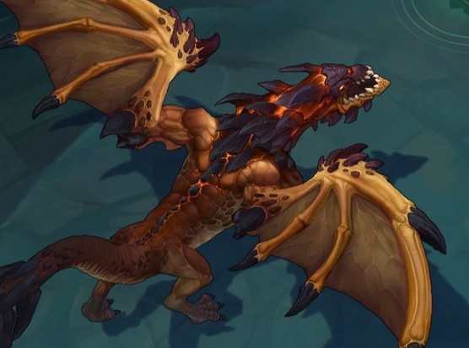
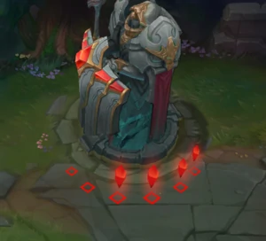
Exploratory Data Analysis
Dragon: grants armor, magic resistance, or bonus damage
First blood: first champion kill in the game
Towers: deal damage to enemies and provide vision
Teams which kill first dragon, get first blood or destroy more towers has a higher win rate.

Slide 6
CV PIPELINE STEP 1: Data Splitting
IID Data
No missing values
No group structure
No time series data
No need to preprocess labels
Train_test_split & k-fold

Slide 7
CV PIPELINE step 2: Data preprocessing
StandardScaler
blueWardsPlaced
blueWardsDestroyed
blueKills
blueAvgLevel
blueDeaths
blueAssists
blueTotalExperience
blueTotalMinionsKilled
blueTotalJungleMinionsKilled
blueCSPerMin
blueTotalGold
blueGoldDiff'
blueExperienceDiff
blueGoldPerMin
…Same for the red team
OneHotEncoder
blueFirstBlood
redFirstBlood
blueHeralds
redHeralds
blueDragons
redDragons
blueTowersDestroyed
redTowersDestroyed
blueEliteMonsters
redEliteMonsters
Training set:
X:(6322,44) y:(6322, 1)
Validation set:
X: (1581, 44)
y: (1581, 1)
Testing set:
X: (1976, 44)
y: (1976, 1)
GridSearchCV
Metric: accuracy_score
CV: k-fold
Fit Model on X_Other

Slide 8
ML Algorithm: LOGISTIC REGRESSION
Lasso
C: [0.01, 0.1, 1, 10,100]
Penalty: l1
solver: [“liblinear”, “saga”]
Ridge
C: [0.01, 0.1, 1, 10,100]
Penalty: l2
solver: [“liblinear”, “saga”, “lbfgs”, “sag”, “newton-cg”]
Elastic Net
C: [0.01, 0.1, 1, 10,100]
Penalty: l2
solver: [“saga”]
l1_ratrio: np.linspace(0.1,1,10)

Slide 9
ML Algorithms
Decision Tree
max_depth: [1, 2, 3, 5, 10, 50, 100]
max_features: [0.1, 0.25, 0.5, 0.75, 1.0]
Random Forest
max_depth: [1, 2, 3, 5, 10]
max_features: [0.25, 0.5, 0.75, 1.0]
K-nearest Neighbors
n_neighbors: [1, 10, 30, 50, 100]
weights: [“uniform”, “distance”]

Slide 10
Results
METHODS | ACCURACY
Logistic Regression with L2 | 0.72864 +/- 0.00527
Logistic Regression with Elasticnet | 0.72814 +/- 0.00469
Logistic Regression with L1 | 0.72794 +/- 0.00310
Random Forest | 0.72318 +/- 0.00432
K-nearest Neighbors | 0.71852 +/- 0.00558
Decision Tree | 0.71812 +/- 0.00930
Baseline | 0.50096

Slide 11
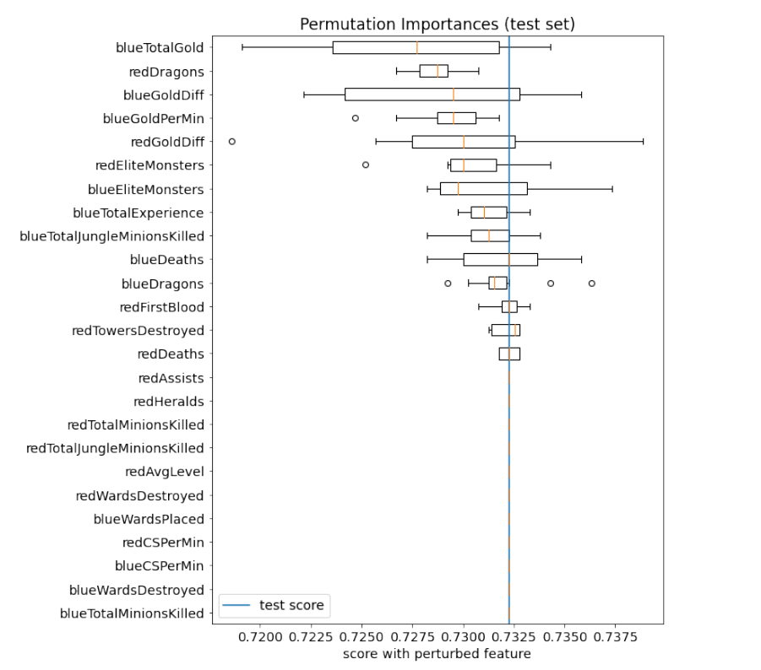

Results
The most important feature: blue total gold
Least important features. kills and deaths
Four of the top five features are related to gold.
Dragons and Elite Monsters are second important features.
The placing and destroying wards have little impact on the outcome the game.

Slide 12

Outlook
The accuracy score of the best model is not very high and all models are around 0.72.
Possible to try other techniques such as XGBoost
More information could be included:
Compositions of champions in each team
Internal relations between champions
players’ experiences on specific champions

Slide 13

Thank you for listening!

